Slide 1


Slide 2






About Us
Web and App Development
Embedded System
Aqualink Bangladesh Ltd. works with clients to design and develop all sort of hardware and software solution. Our solutions are fully focused on our user that emphases on client first.
Industrial Automation
Artificial Intelligent
Machine Learning
Internet of Things

Slide 3


Slide 4

Overview
Covid-19 has already become an international pandemic. Over time the world has faced this type of pandemics like Spanish flu(1918-1919),Black Death(1347-1351), which had a huge impact on mankind. Different countries have enriched their funds in the research & development sectors to fight against these pandemics. From an overly populated developing country like us are we ready enough to fight this war! Considering this situation in mind we are introducing an archive of data analytics BengalHUB. BengalHUB will work as a centre of research for the researchers and data scientists. It will connect researchers from different sectors and levels together to solve all kinds of problems of our country including covid-19.
Research on Covid-19.
Archive of Data Analytics.
A Platform to Connect Researchers
Doing Something Big Together

Slide 5
Why do we need BengalHUB?
World scenario:
Using data analysis tools to find the nature of coronavirus
Predicting approximate time period of Covid-19 pandemic
Comparing Covid-19 with other pandemics based on information
Analysing the causes of its transmission
Taking appropriate measures in advance
Training machines to predict the future.
BengalHUB will work as a platform to start this types of research works in Bangladesh

Slide 6
Why do we need BengalHUB?
Bangladesh scenario:
Research work is going on Covid-19 in different universities.
Very scattered and low exposed
Difficult to gather structured information
Lack of resources
Costly computational power
No predictive models used to take actions in advance
Lack of resource sharing platform for the researchers
BengalHUB will help the researchers to work together by sharing their contributions, resources, knowledge and findings by publishing here.

Slide 7
World Data Driven Research Works
Oxford-based Exscientia, the first to put an AI-discovered drug into human trial, is trawling through 15,000 drugs held by the Scripps research institute, in California.And Healx, a Cambridge company set up by Viagra co-inventor Dr David Brown, has repurposed its AI system developed to find drugs for rare diseases.
https://www.bbc.com/news/technology-52120747
Taiwan used data and a robust pandemic plan created after the 2003 SARS outbreak to minimize the virus’ impact on its land.
https://www.forbes.com/sites/bernardmarr/2020/04/09/the-vital-role-of-big-data-in-the-fight-against-coronavirus/#645c47d43806
Bangladesh pandemic will end on 15 july 2020 ,data driven research by a team of Singapore University of Technology.
https://www.altaveu.com/documents/covid19predictionpaper20200426.pdf

Slide 8
World Data Driven Research Works
More than 96% of the population will get affected by covid-19 and transmit it without developing serious symptoms.
https://medium.com/@ali_razavian/covid-19-from-a-data-scientists-perspective-95bd4e84843b
Which Countries React Similar to COVID-19? Machine Learning provides the Answer
https://towardsdatascience.com/which-countries-react-similar-to-covid-19-machine-learning-provides-the-answer-5971ec2f6f31
When would COVID19 be over from a data science perspective and what’s the fatality rate?
https://medium.com/@ali_razavian/covid-19-from-a-data-scientists-perspective-95bd4e84843b

Slide 9
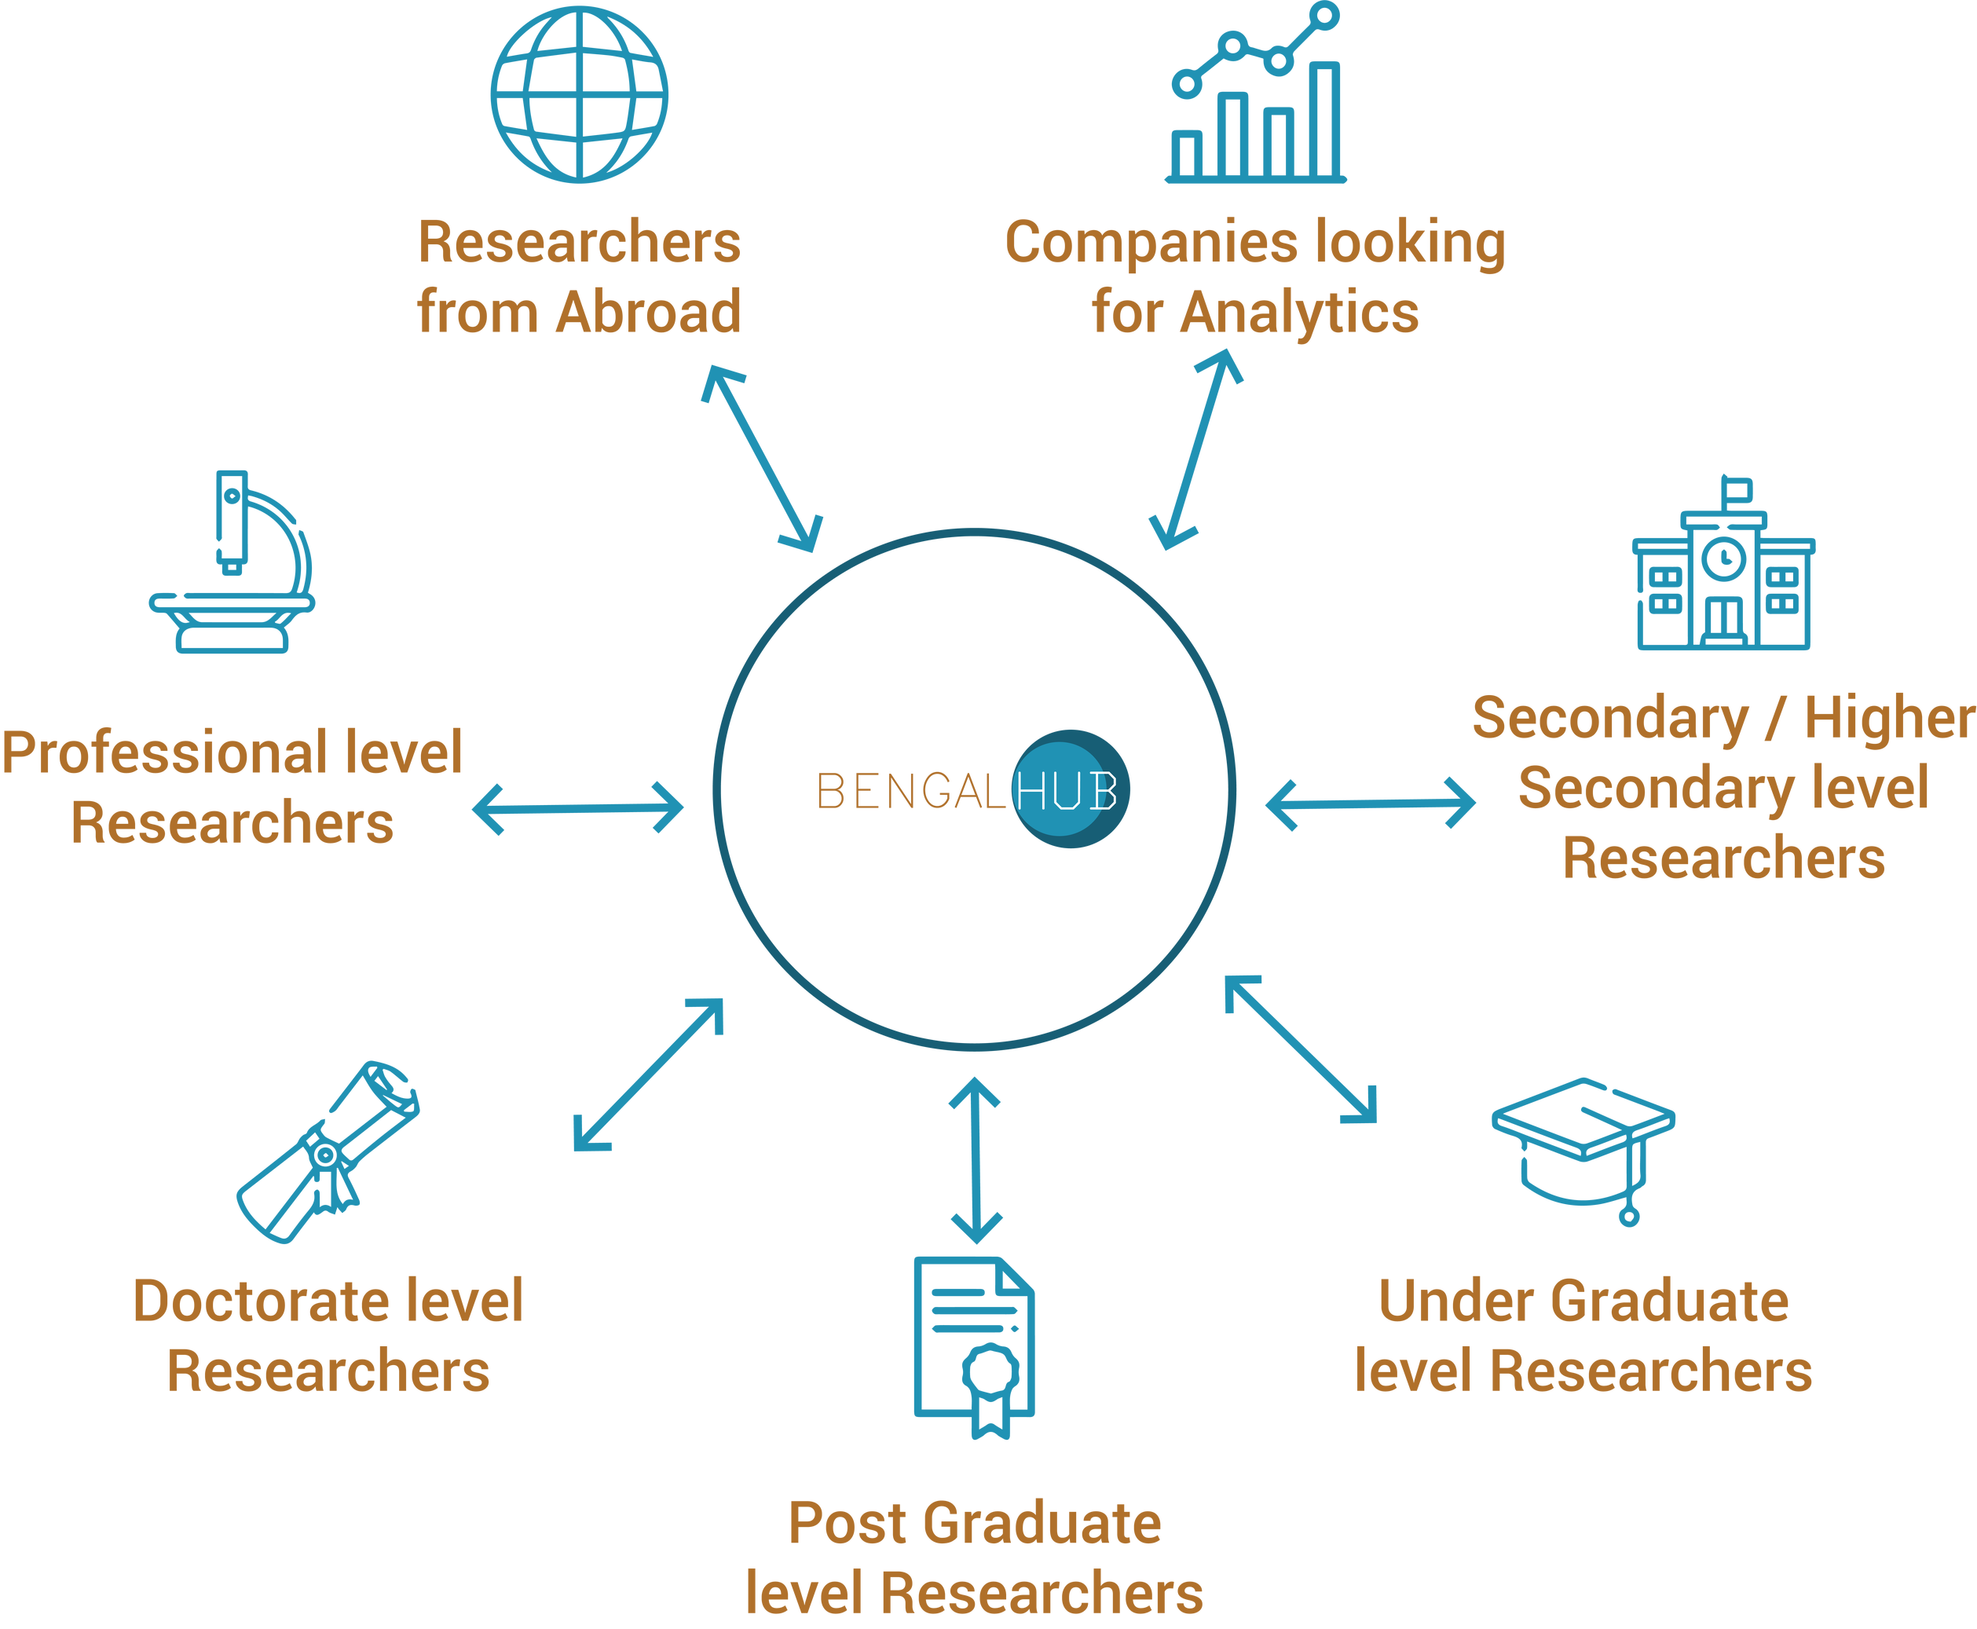
Features of BengalHUB
Research on Covid-19.
Archive of Data Analytics.
A Platform to Connect Researchers.
Researchers can share their research work.
Research guideline.
Easily Accessible Data warehouse.
Contribution from every sector.
Support for the companies looking for
data scientists.

Slide 10
Features of BengalHUB
With the help of a2i(Access to Information) if we have access to different types of Covid-19 data, we can build some future prediction models to help our nation come out from this pandemic. Models willing to make:
Predict time period of this Covid-19 pandemic
Forecast on Bangladesh future Covid-19 positives cases.
Find effect of Covid-19 on different age groups
Analysis on appropriate quarantine rules in Bangladesh context.
Predicting patients condition to assist the doctors
Estimating the appropriate number of tests for our country
Finding effective tactics to win the battle with data analytics
Research on preventing future pandemics
Data driven comparative analysis of bangladesh

Slide 11

Feature
NIGHTINGALE
Doctor or nurse can monitor patient using this robot.
All feature in one robot and it can be replaceable.
For disinfection it can be use in
Indoor (Hospital, office etc.)
Outdoor (streets, big area, etc.)

Slide 12
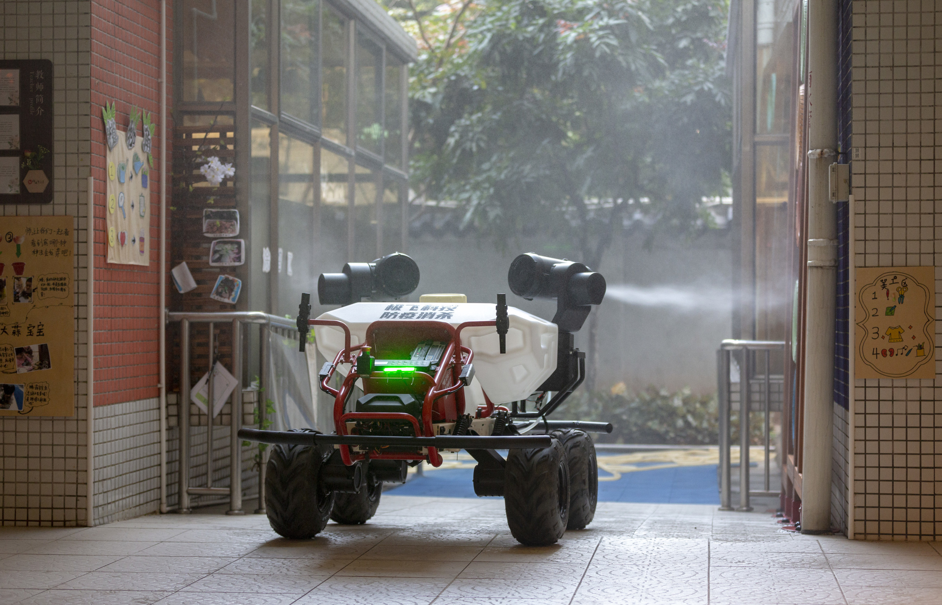
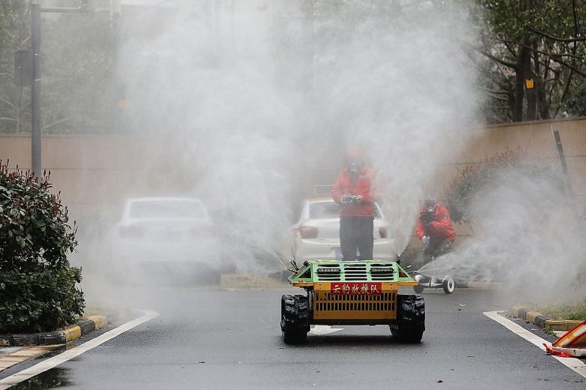
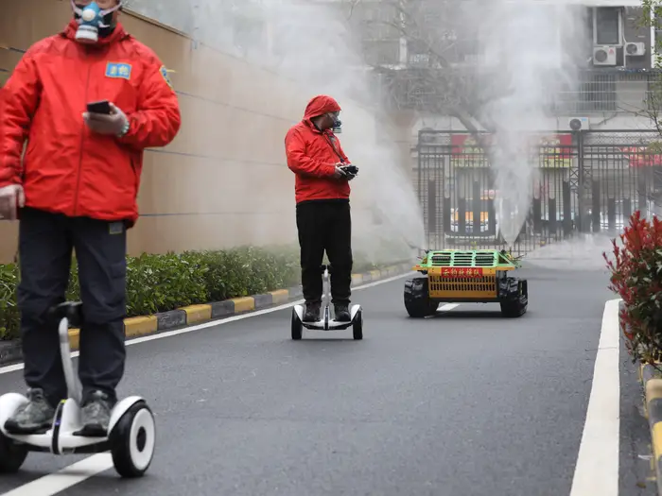
Outdoor Disinfection (spray)
NIGHTINGALE

Slide 13
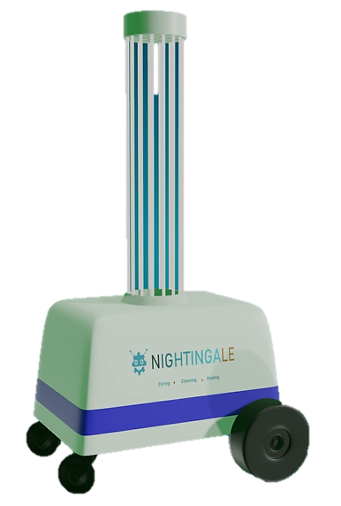
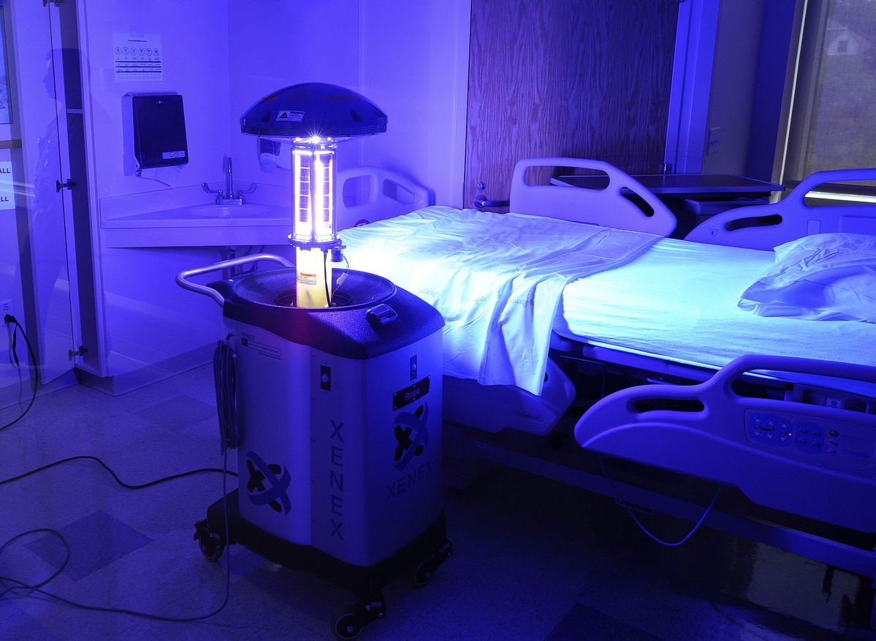
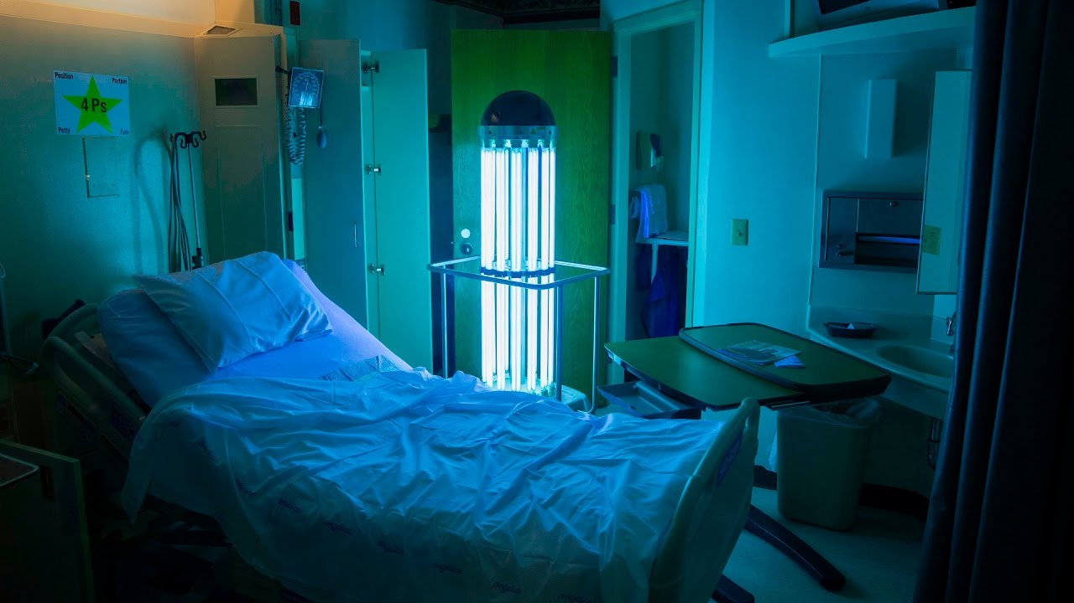
Indoor disinfection (UVC light)
NIGHTINGALE

Slide 14
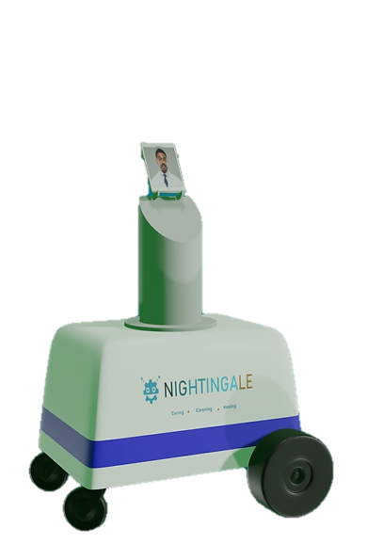
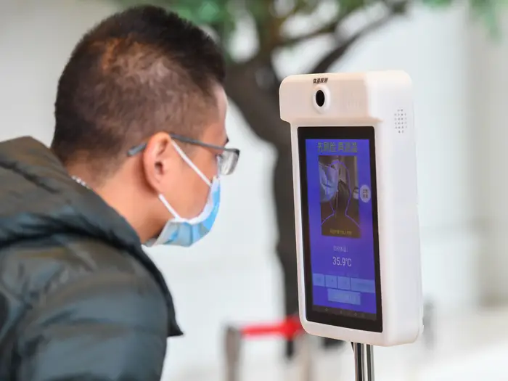
Consulting With Doctor or Nurse Via Video call
NIGHTINGALE

Slide 15
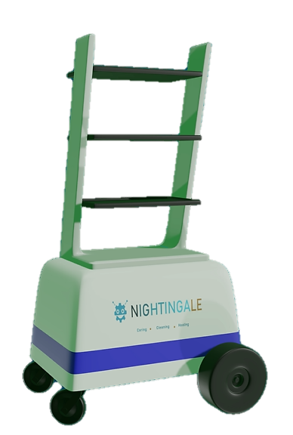
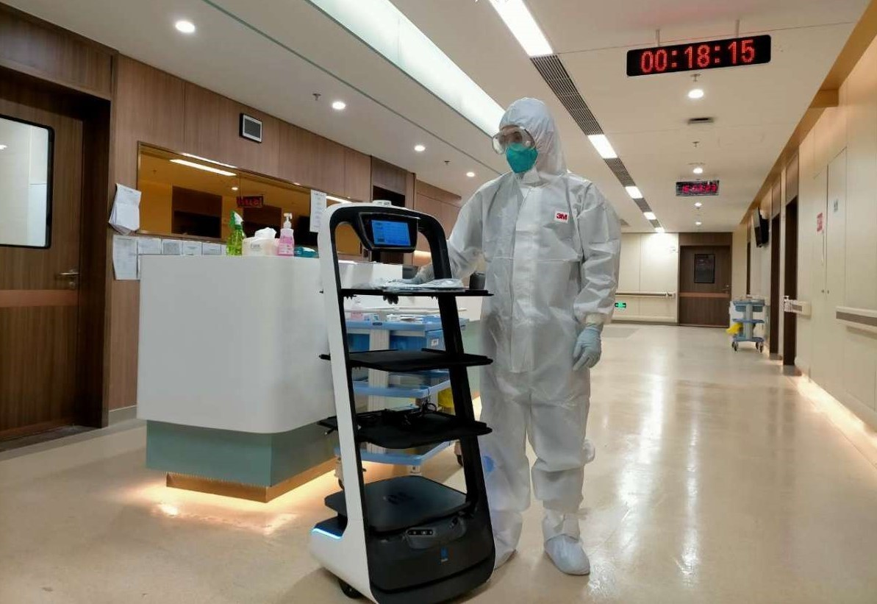
Giving Medicine and Food to the patient
NIGHTINGALE

Slide 16
Benefits of Using NIGHTINGALE
NIGHTINGALE
BEFORE
AFTER
Physical Disinfecting Process.
High Risk of Spreading.
Doctors are getting affected.
High Human Interaction.
Difficult to attend other patients.
No Contact Disinfection.
Very Low Risk of Spreading.
Doctors can take Care Remotely.
No Human Interaction.
Doctor can Provide Attention to all.

Slide 17
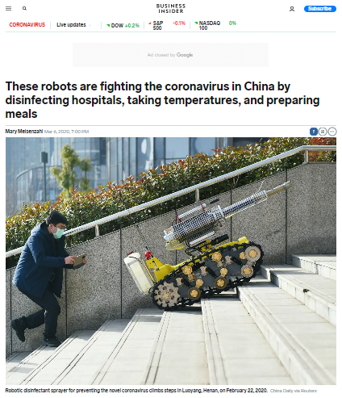
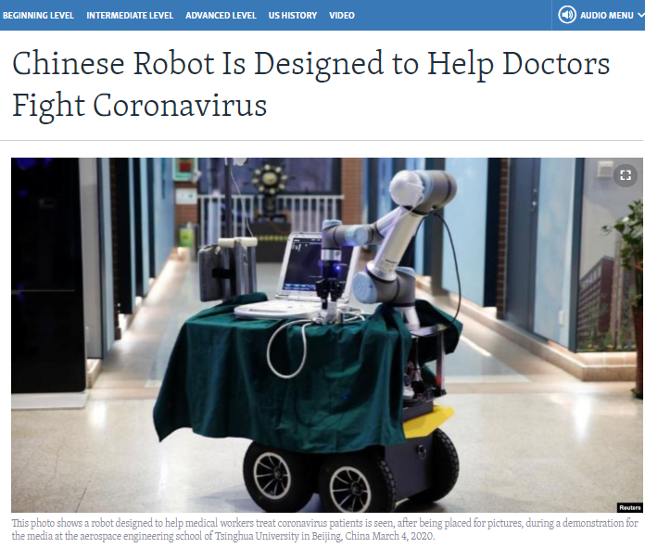
Solution in Detailes
NIGHTINGALE
Considering the unfortunate pandemic situation of COVID-19, robots could be used in order to help our country. Robots can be used behind the scenes as well, delivering meals to patients, removing soiled linens, monitoring medical inventory, and distributing medical supplies. They can even serve as automatic room sanitizers when equipped with UV-C sterilising lights.

Slide 18
Team Experience in Robotics
NIGHTINGALE

Slide 19
Team Experience in Robotics
Qualifier in University Rover Challenge (URC) 2017.
Worked in NASA Chondroboat with huge Success.
Worked with Bangladesh Ordnance Factory to make a Grenade Disposal Robot.
Champion in Hackathon 16
NIGHTINGALE

Slide 20
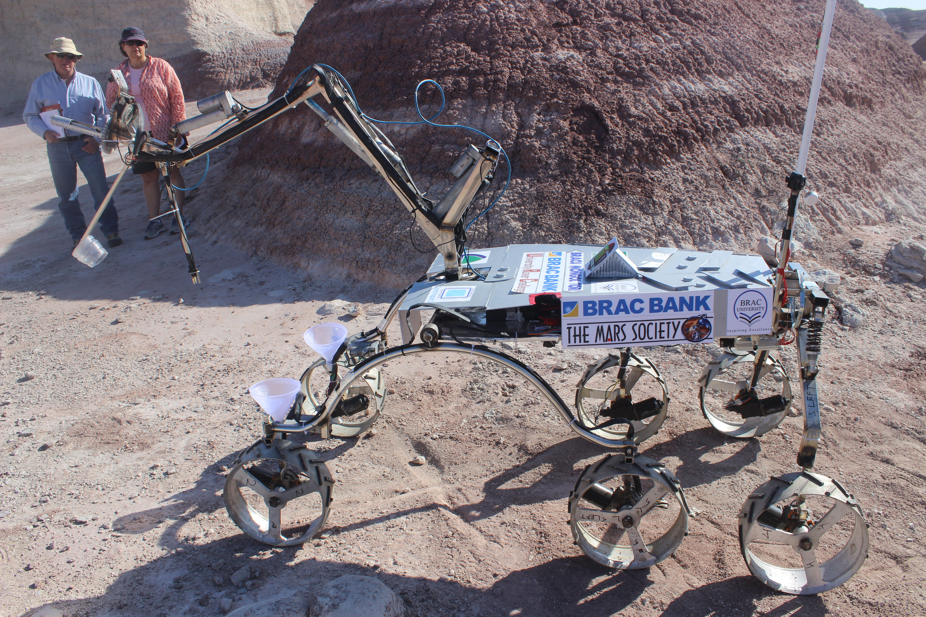
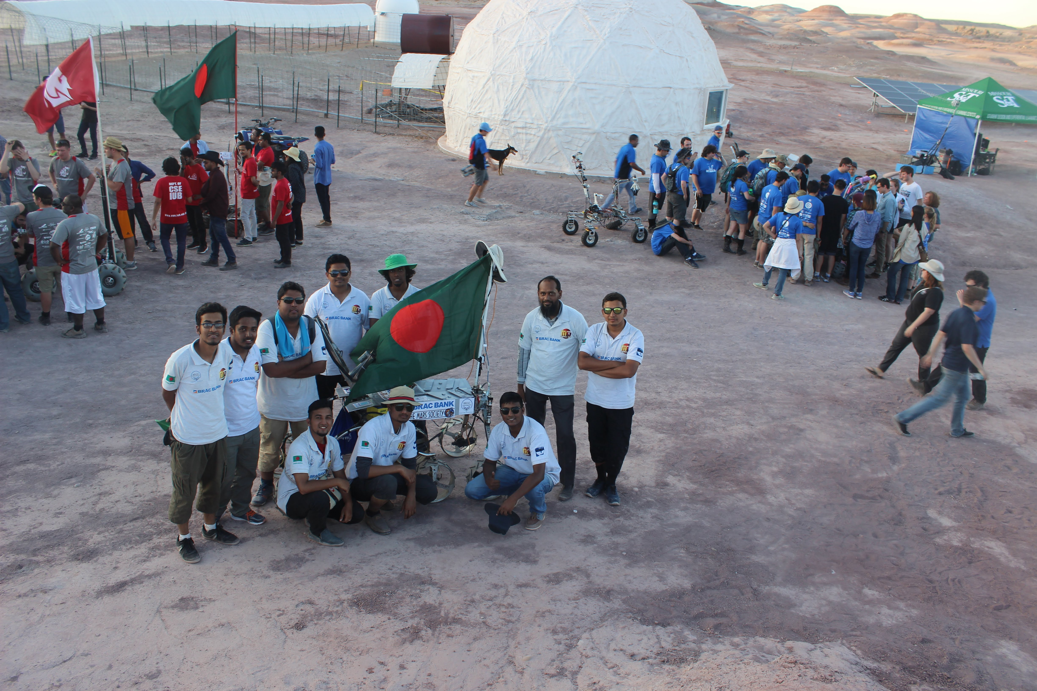
University Rover Challenge (URC) 2017
Some of our Enthusiastic Team Members Represented Bangladesh with their creation in University Rover Challenge (URC) 2017 in USA.
NIGHTINGALE

Slide 21
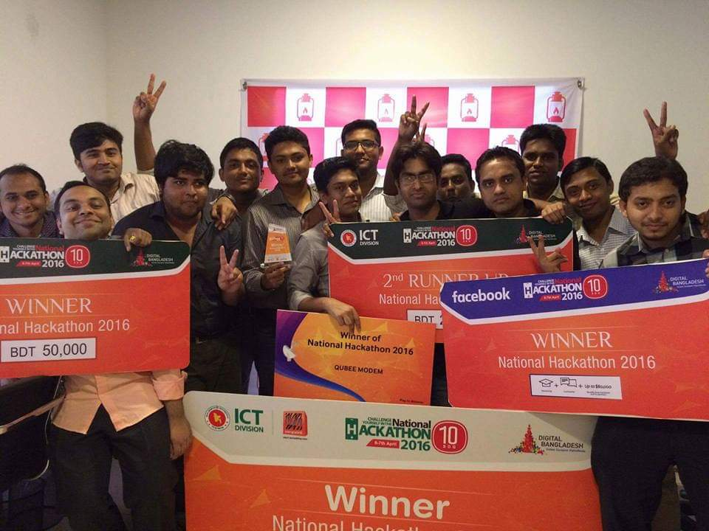
Champion in Hackathon 16
NIGHTINGALE

Slide 22
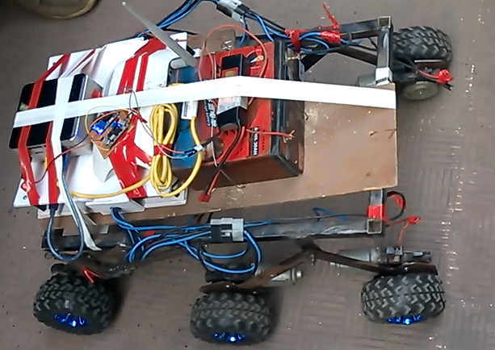
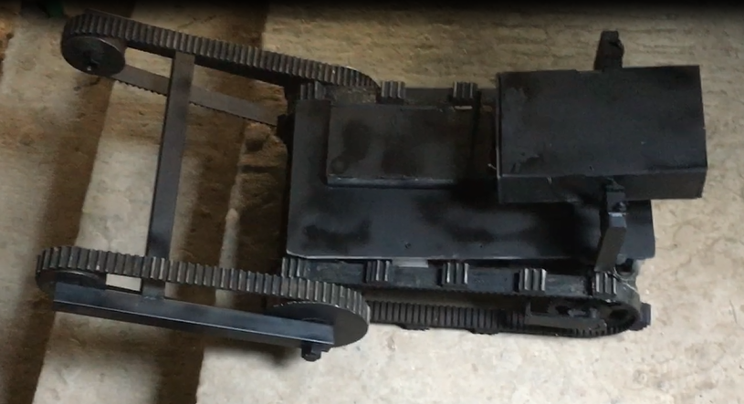
Grenade Disposal Robot for BOF
NIGHTINGALE

Slide 23
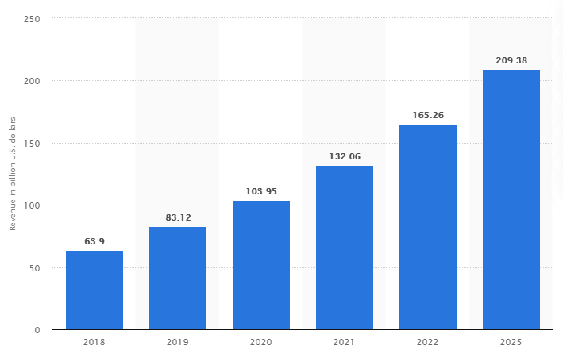
Market Scenario
NIGHTINGALE
Global market size for robots between 2018 and 2025

Slide 24



Marketing Opportunities
NIGHTINGALE
USD 17, 561 Million
Global Smart Robot Market is expected to reach
GDP USD 315 Billion
Bangladesh GDP expected to reach by the end of 2020
168th in the Global
Bangladesh rose to this rank for ease of business
Setting up a new business became less expensive with the reduction of registration and name clearance fees and digitalization

Slide 25
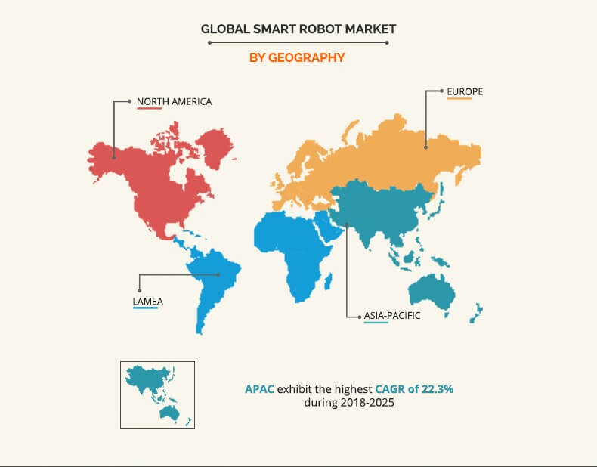
Marketing Opportunities
NIGHTINGALE

Slide 26
Development process of the solution
NIGHTINGALE
Prototype
Design Implementation
Start Production
First One Week
Last Three Weeks
Total One Month of Relentless Efforts will Make The Project Commercially Viable

Slide 27
Future Developments
NIGHTINGALE
Instant Sample Testing
Thermal Imaging to detect infected people
Checking Patient History
Patient Entertainment to support them
Patient Assistance in Hospitals
Upcoming Features

Slide 28
Other Scope
NIGHTINGALE
Surveillance
Monitoring
Security and Safety

Slide 29
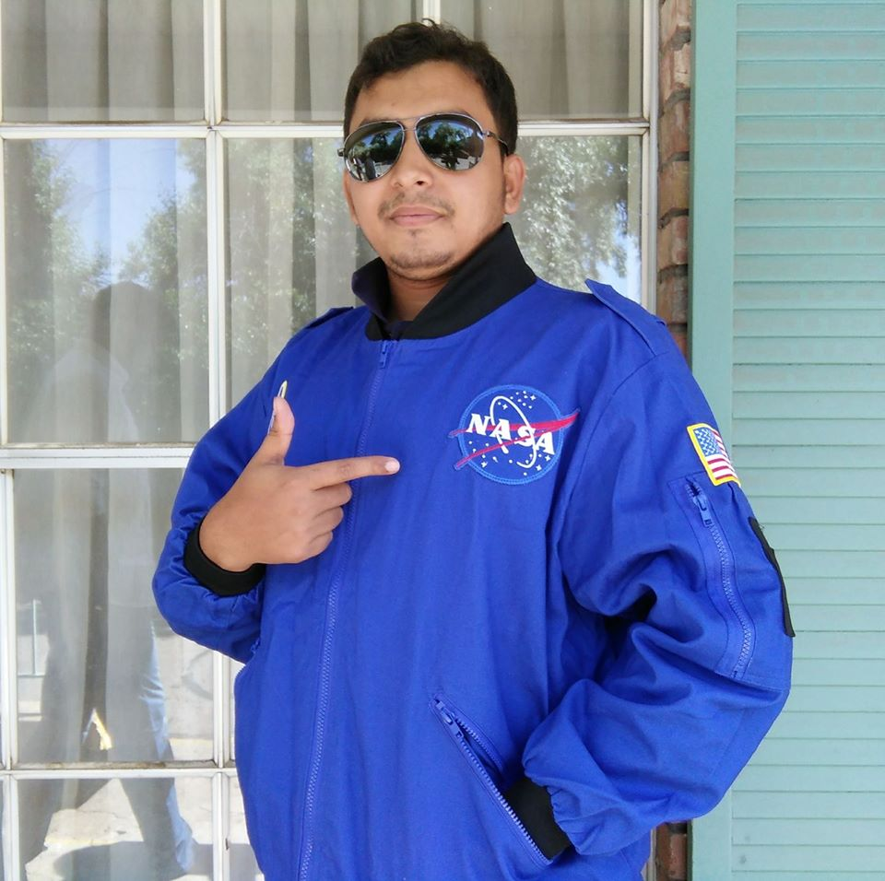

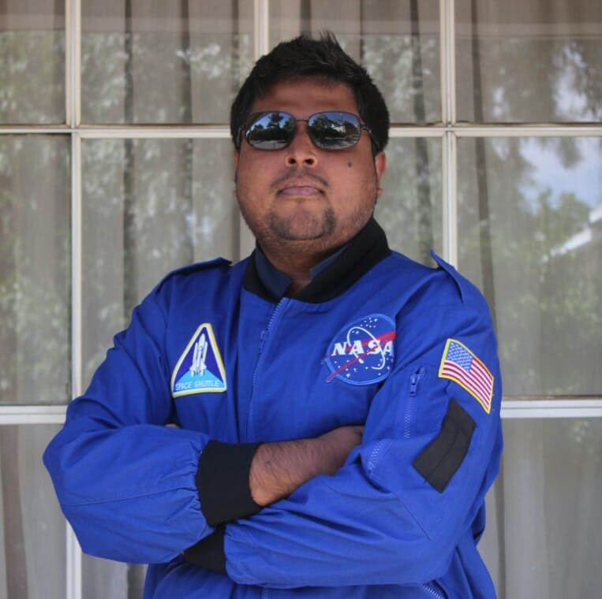


Team Profile
NIGHTINGALE
Niaz Sharif Shourov
Head of Operations
Aqualink Bangladesh Ltd.
Sayed Rizban Hossain
Head of Software Development
Aqualink Bangladesh Ltd.
Masnur Rahman
Head of Embedded System
Aqualink Bangladesh Ltd.
Md Fahim Shahriar Sakib
Embedded System Engineer
Aqualink Bangladesh Ltd.
Sakif Ryhan
Business Development
Aqualink Bangladesh Ltd.

Slide 30








Our Clients
NIGHTINGALE

Slide 31




NIGHTINGALE
Contact Info
+880-1675932265
office@aqualinkbd.net
House No. 26, Road No. 28, Block – K
Banani, Dhaka 1212.
www.aqualinkbangladesh.com
NIGHTINGALE

